Slide 1
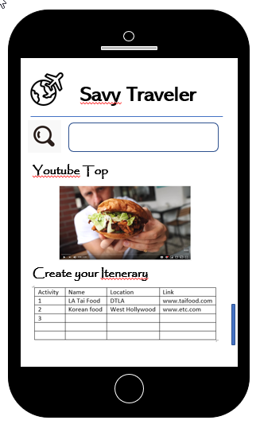
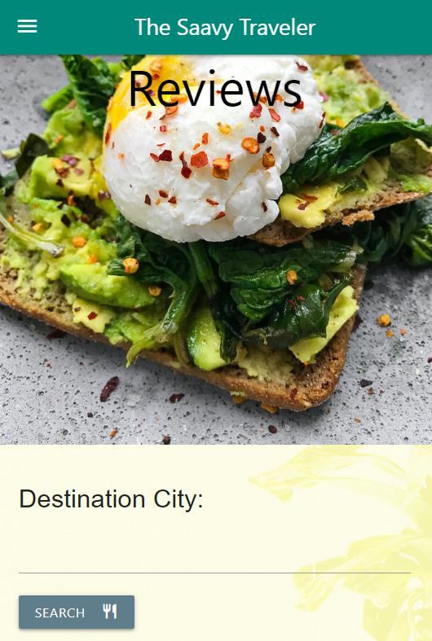
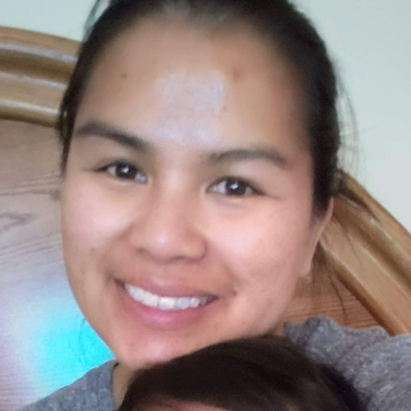

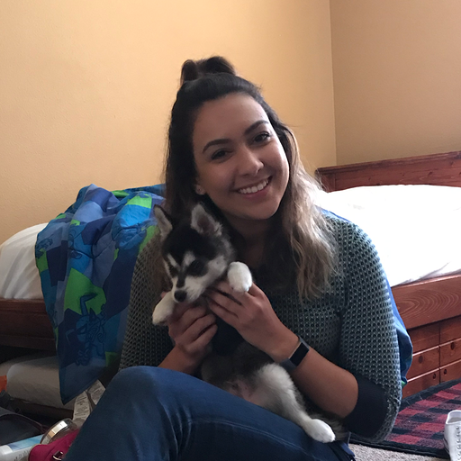

Project 2:
Using API’s to Help Travelers
Team Members:
Hazel Reyes
Sonia Pandit
Ana Pineda
Andres Ruiz

Slide 2
App Concept: Savvy Travels
Using API’s to Help Travelers
Target Audience: Travelers
Problem : When planning a trip, Travelers want to visit and experience the best local food. This task can quickly get overwhelming with the endless possibilities. The traveler can experience “Analysis Paralysis”
Solution : Allow the travels to only browse the best reviews and rated restaurants and activities provided by the Yelp and YouTube APIs. Additionally the user can create their own itinerary based on the search results.
Motivation: Want to focus on the excitement of traveling.

Slide 3
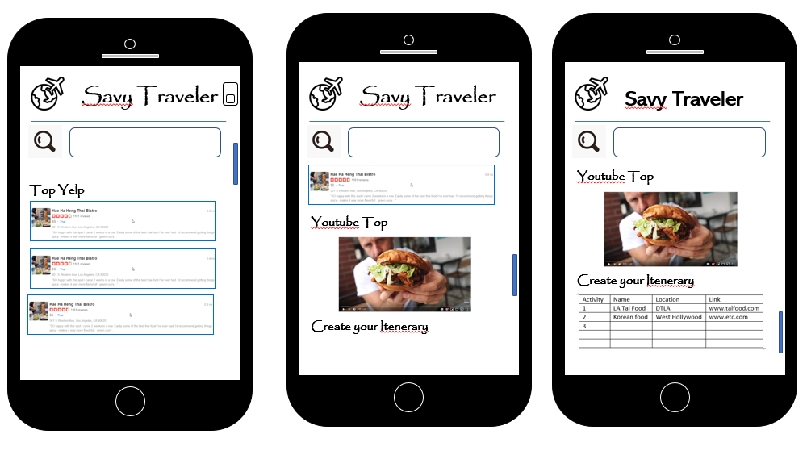
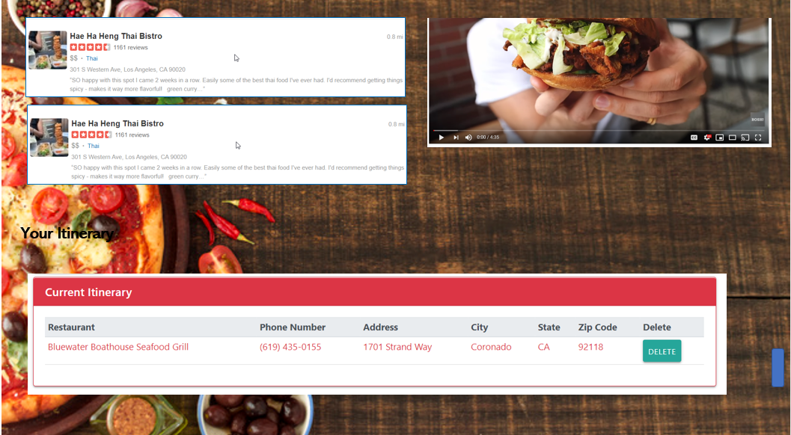
Design Process
Mobile
Desktop
Created Mock Up on Powerpoint

Slide 4






New Technologies

Slide 5

Demonstration

Slide 6
New Features
Updated Mobile friendly response and improved visual features such as the hover icons.
New link to restaurant Yelp page directly from itinerary
Added dark mode option
Added login
Database storage instead of local storage

Slide 7
Needed Improvement
Better use of database for login
Add affiliate links for the user to purchase related products
Polish the overall look of the page

